Slide 1


Code of Human rights
& social principles
POL 006/A1

Slide 2

Statement
Our commitment to respect and promote human rights and social principles in every place we operate including our business partners and supply chain:
Deutsche Telekom Group and Makedonski Telekom take all internationally recognized human and social rights seriously and acknowledges its responsibility as a leading global telecommunications company. The success of our Company is built on our high standards of quality, integrity and excellence and we ensure our respect for human rights.

Slide 3

Bearing in mind its responsibility as an international corporate group...
    Respecting the cultural, ethical, social, political and legal diversity of the nations and societies
    in which we operate as a corporate group
    Aware of the necessity to satisfy today’s needs in a socially, economically and ecologically
    well-balanced manner which takes due account of the protection of the living and working conditions of future generations
    We are committed to always abide by and promote human and social rights in reference to the responsibilities that emerge through technological change and digitization.
    In accordance with internationally recognized norms, directives and standards, in particular those of the
      International Bill of Human Rights,
      the ILO Core Conventions,
      the OECD Guidelines,
      the Global Compact,
      the Tripartite Declaration of Principles concerning Multinational Enterprises
      and Social Policy (MNE Declaration),
      and Guiding Principles on Business and Human Rights.
Deutsche Telekom and Makedonski Telekom embrace the following Basic Human Rights & Social Principles:

Slide 4

Basic Human Rights & Social Principles
    Deutsche Telekom Group and Makedonski Telekom …
    acknowledges and respects the cultural, social, political and legal diversity of all nations and societies and is committed to respecting and promoting internationally recognized human rights on an ongoing basis;
    recognizes the fundamental right to the freedom of association and the right to collective bargaining within the scope of national regulations and existing agreements. Also declares itself in favour of cooperating with legitimate democratic employee representations in an open and trusting manner based on a constructive social dialog with the aim of achieving a fair balance of interests;
    emphatically declares itself in favor of prohibiting any and all kinds of forced labor, human trafficking and modern slavery;
    is committed to the abolishment of exploitative child labor and guarantees that at least the minimum age for admittance to employment is observed within the Deutsche Telekom Group and Makedonski Telekom in accordance with the regulations;
    rejects any form of discrimination at the workplace and declares itself in favor of the promotion of equal opportunities as well as diversity of all employees in terms of gender, age, culture, religion, abilities and sexual orientation;
    is committed to treat all employees with respect without using any form of corporal punishment, mental or physical coercion, abuse or harassment, or the threat of such treatment;
    observes the right to reasonable remuneration on the basis of a contract in line with the respective national labor market stipulating at least the minimum wages guaranteed by law and guarantees the observance of the respective national regulations on hours of work and on regular paid vacation;

Slide 5
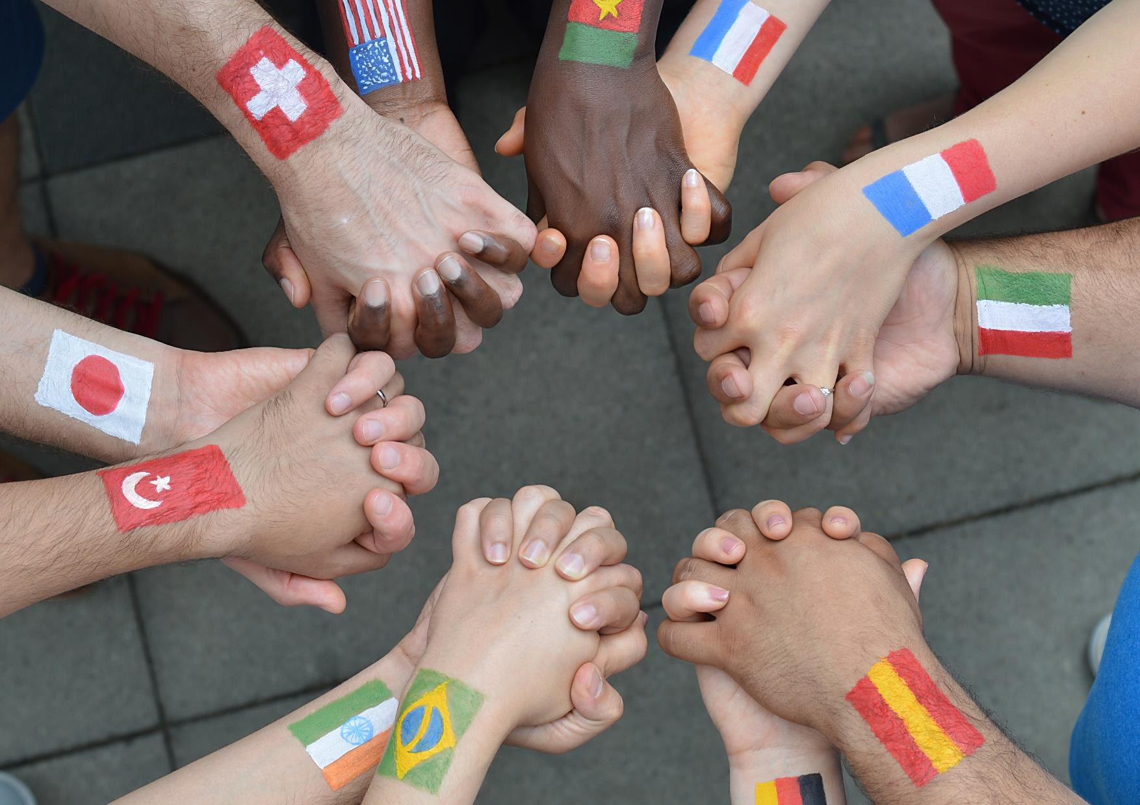
Basic Human Rights & Social Principles
    Deutsche Telekom Group and Makedonski Telekom …
Support skills development in the interests of both the employees and the company in order to guarantee a permanently high standard of performance and a high service quality. At the same time, Furthermore it emphasizes and fosters the personal responsibility that employees have to maintain and improve their employability;
See the health of its employees as a major value for the company and endeavours the protection of health and safety of its employees. For this reason, adherence at least to the standards applicable in each country at sites all over the world should be ensured and the further development thereof should be supported to improve the working environment;
Is committed to environmental protection and fostering the positive impacts of sustainability in business.

Slide 6

Aspiration and scope of validity and modification
Deutsche Telekom Group and Makedonski Telekom strive to meet the international standards and not to infringe on human rights where national law and regulations and/or their implementation are not sufficient or are absent.
Deutsche Telekom Group and Makedonski Telekom declares the observance and application of the Code of Human Rights & Social Principles as binding worldwide.
This Code is periodically reviewed in light of national and international developments and, if necessary, modified.

Slide 7
Implementation
Makedonski Telekom AD- Skopje shall train/ make familiar the Code of Human Rights & Social Principles to its employees, relevant stakeholders and suppliers and expects the latter to declare themselves willing to observe, respect and apply the same principles throughout their operations and business relationships.
Further, Makedonski Telekom has set up a point of contact for Human Rights at corporate level, that will deal with internal and external inquiries.
The managers of the all organizational units are responsible for the observance of the Human Rights & Social Principles.
Makedonski Telekom further reserves the right to check the observance of Human Rights & Social Principles in a suitable manner by spot checks and/or if there is a well- founded suspicion. Upholding the principle of transparency, Makedonski Telekom is committed to sharing its progress on the implementation of the Principles on a regular basis.
Additionally, Deutsche Telekom:
Assesses and monitors adherence to human rights in its business activities through continuous human rights due diligence process, which include regular impact assessments across organizational units.
Undertakes an annual review to verify the observance of this Code by all group companies and publishes the results in the Human Rights & Social Principles Performance Report.
Communication and Transparency
  Upholding the principle of transparency, Deutsche Telekom Group and Makedonski Telekom is committed to sharing its progress on the observation and implementation of the Human Rights & Social Principles on a regular basis with both internal and external stakeholders.

